Slide 1

Continuous security for cloud-native applications
Red Hat® Advanced Cluster Security
for Kubernetes, powered by StackRox
Johan Odell
Solution Architect @ Red Hat

Slide 2
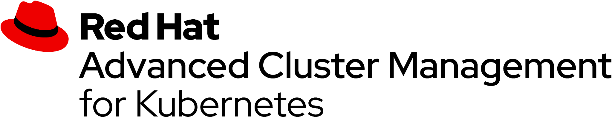


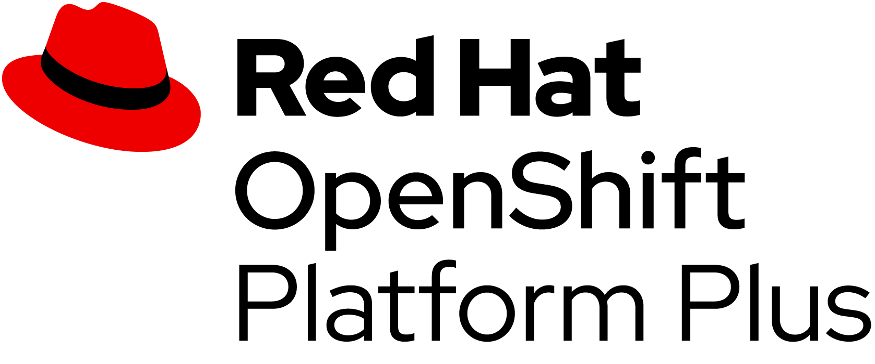








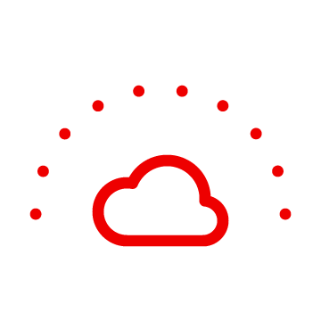
OpenShift Platform Plus
Multicluster management
Cluster security
Global registry
Observability | Discovery | Policy | Compliance | Configuration | Workloads
Declarative security | Container vulnerability management | Network segmentation | Threat detection and response
Image management | Security scanning | Geo-replication Mirroring | Image builds
Manage workloads
Build cloud-native apps
Data-driven insights
Developer productivity
Platform services
Application services*
Data services*
Developer services
• Service mesh | Serverless • Builds | CI/CD pipelines
• Log management • Cost management
• Languages and runtimes
• API management
• Integration
• Messaging
• Process automation
• Databases | Cache • Data ingest and prep
• Data analytics | AI/ML • Data management & resilience
• Developer CLI | IDE
• Plugins and extensions • CodeReady workspaces • CodeReady containers
Kubernetes cluster services Install | Over-the-air updates | Networking | Ingress | Storage | Monitoring | Logging | Registry | Authorization | Containers | VMs | Operators | Helm charts
Kubernetes (orchestration)
Linux (container host operating system)
Physical
Virtual
Private cloud
Public cloud
Edge

Slide 3


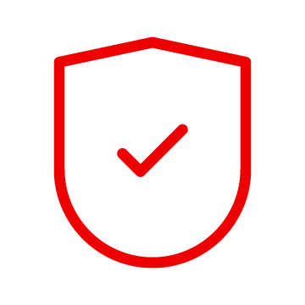
Security must be continuous and holistic
Control Application Security
Protect the Platform
Detect & Respond to Runtime Threats
DESIGN
ADAPT
DEPLOY
RUN
Dev
Ops
BUILD
PACKAGE
MANAGE
ADAPT
Notes:
Security is temporal - whats secure today may not be secure tomorrow.

Slide 4

OpenShift delivers continuous security
Control
Protect
Detect & Respond
ACM
Application Lifecycle and Locality
Fleet Management
Fleet Observability & Alerts
Vulnerability analysis
Policy admission controller
Runtime behavioral analysis
ACS
App config analysis
Compliance assessments
Auto-suggest network policies
APIs for CI/CD integrations
Risk profiling
Threat detection / incident response
Trusted content
Kubernetes platform lifecycle
Container isolation
Container registry
Identity and access management
Network isolation
OCP
Build management
Platform data
Application access and data
CI/CD pipeline
Deployment policies
Observability
BUILD
DEPLOY
RUN
DevSecOps
Notes:
Allows you from day one (installation takes about 15-20 minutes)

Slide 5


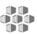






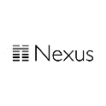



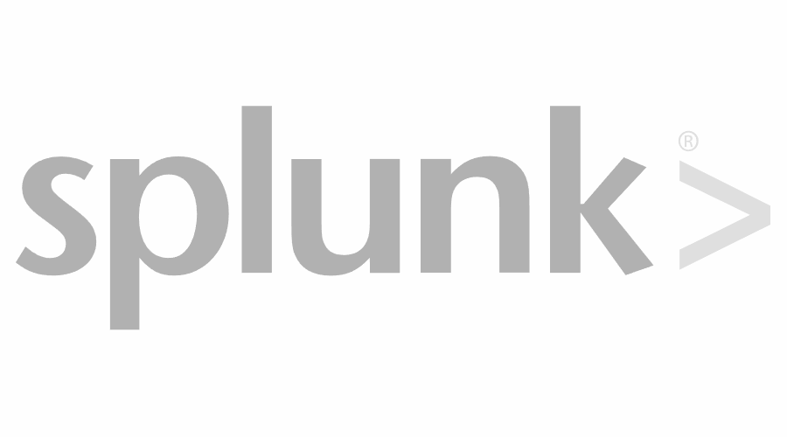





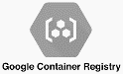



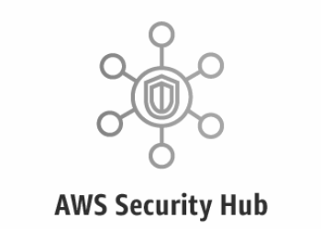
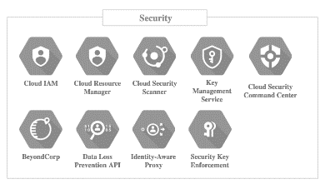



The first Kubernetes-native security platform
Continuous security for cloud-native applications
Red Hat Advanced Cluster Security for Kubernetes
Any Kubernetes distribution
Build
Secure supply chain
Deploy
Secure infrastructure
Run
Secure workloads
Policy engine
API
Image scanning
Registries
CI/CD tools
DevOps notification
SIEM
Run anywhere
Public cloud
Private cloud
Hybrid/Multi-cloud
AWS Security Hub

Slide 6
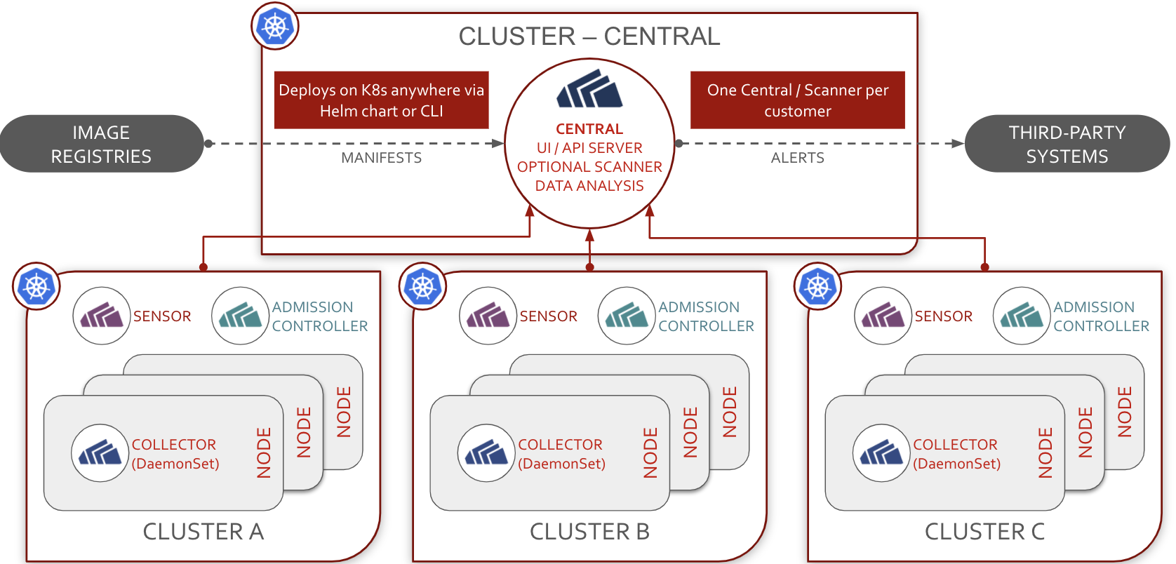
Architecture
Continuous security for cloud-native applications

Slide 7
DEMO
Notes:
Create Project with nodeselector and tolerations
We will create a physical isolation of pods to run on specific nodes using node-selectors, taints and tolerations.
We will create a dedicated ingress per network zone.
Deploy applications to respective Projects/namespaces and see what happens.
Create network policies
If time: Create a tier 3 app demo using gitops

Slide 8
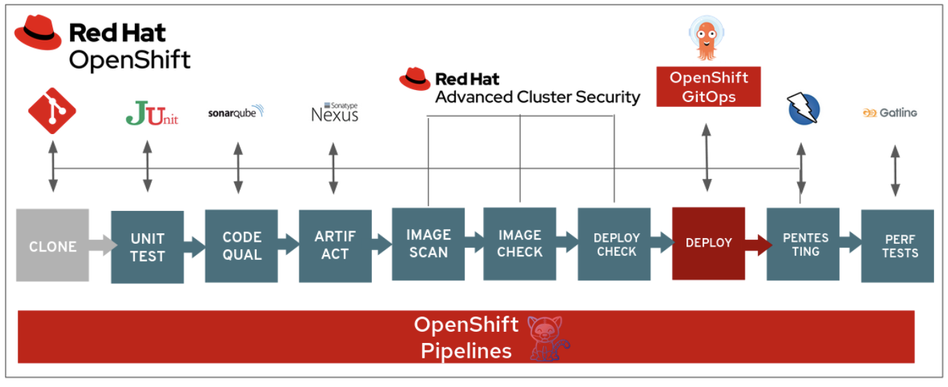
DevSecOps Demo
Vulnerability and configuration management methods included in this demo are the following:
Static application security testing (SAST)
Software composition analysis (SCA)
Interactive application security testing (IAST) and dynamic application security testing (DAST)
Configuration management
Image risk is any risk associated with a container image. This includes vulnerable dependencies, embedded secrets, bad configurations, malware, or images that are not trusted.

Slide 9
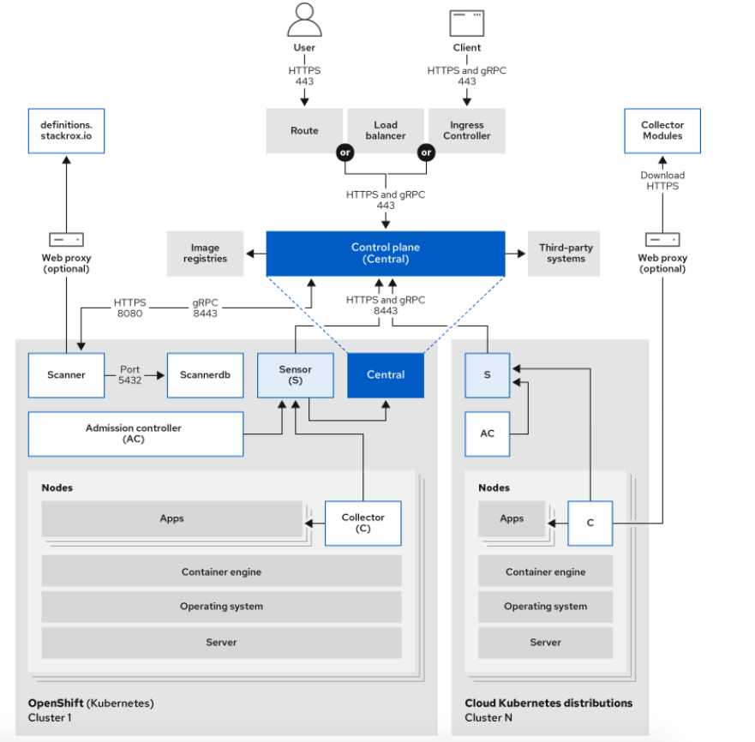
Notes:
Central: [Centralized component] Central is the main component of RHACS and it is installed as a Kubernetes deployment. It handles data persistence, API interactions, and user interface (portal) access. You can use the same Central instance to secure multiple OpenShift Container Platform or Kubernetes clusters.
Scanner: [Centralized component] RHACS includes an image vulnerability scanning component called Scanner. It analyzes the image layers to check for known vulnerabilities from the Common Vulnerabilities and Exposures (CVEs) list. Scanner also identifies vulnerabilities in packages installed by package managers and in dependencies for multiple programming languages.
Sensor: [1 per cluster] RHACS uses the Sensor component to monitor Kubernetes and OpenShift Container Platform clusters. It handles interactions with the OpenShift Container Platform or Kubernetes API server for policy detection and enforcement, and it coordinates with Collector.
Admission controller: [1 per cluster] The admission controller prevents users from creating workloads that violate security policies in RHACS.
Collector: [1 per node] Collector collects and monitors information about container runtime and network activity. It then sends the collected information to Sensor.
Scanner only scans those images that are not already scanned by other integrated vulnerability scanners. If you have integrated RHACS with other vulnerability scanners, Scanner checks and uses the scanning results from the integrated scanner if available.

